Slide 1
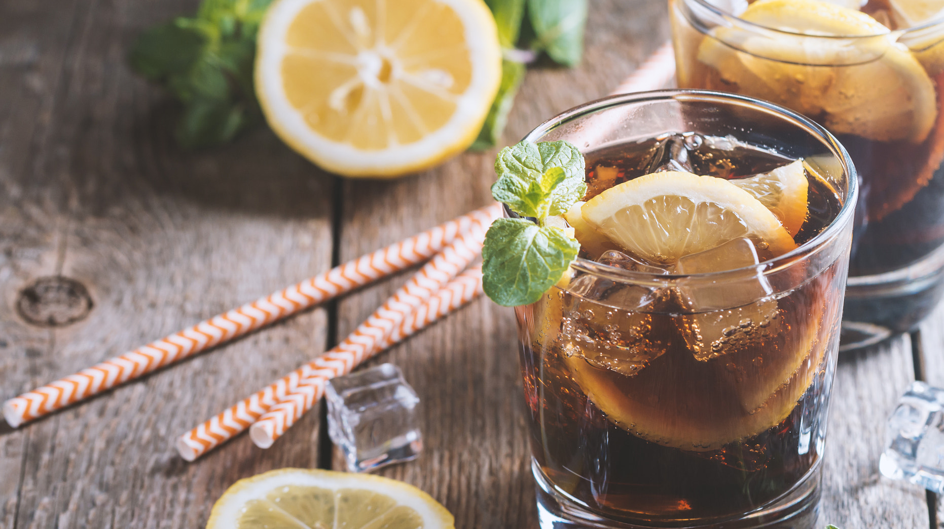
Did you know?
17世纪蔗糖贸易美国，非洲和加勒比海的贸易三角，通过蔗糖贸易快速敛财，为征服新领土提供资金。
糖浆是生产蔗糖的副产品，它的自然发酵引发了人们对它进行蒸馏生产的想法。世界上90%的朗姆酒生产都伴随着蔗糖的生产。
清淡朗姆酒和可乐或酸柠檬/果汁勾兑出最受欢迎的混合饮料。几乎就是为鸡尾酒而生：Cuba Libre, Daiquiri, Mojito, Pina Colada

Slide 2
Tequila 龙舌兰
Color: Clear, light gold, rich amber
Region: The majority are made in the Jalisco state of Mexico (technically it can also be made in Guanajuato, Michoacán, Nayarit, and Tamaulipas)
ABV: Typically 40% ABV
Aged: Blanco/Joven 0-2 months; Reposado 2 months-1 year; Anejo 1-3 years; Extra Anejo at least 3 years
Made from: Blue Weber Agave（蓝色龙舌兰）
Commercial Examples: 1800 Tequila, Patron, Gran Centenario, El Tesoro, Partida, Chinaco

Slide 3
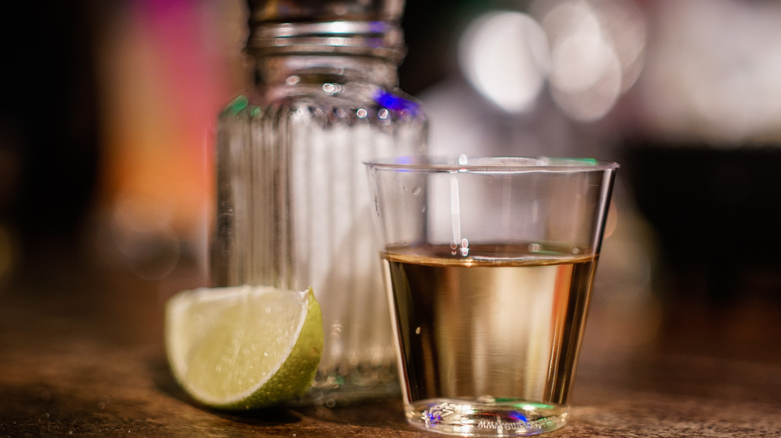
Did you know?
墨西哥国饮：按照墨西哥法规，只有使用了不少于51%的龙舌兰酒精的饮料，才能称为龙舌兰酒。高档龙舌兰酒标上会注明其完全从龙舌兰中提炼，100% Blue Agave的标注。
常常用于净饮。搭配盐和柠檬：往窄小的一口杯中倒入2厘升酒。把盐一下倒进嘴里并吞下，同时喝下龙舌兰酒并且咀嚼柠檬。

Slide 4
Vodka 伏特加
Color: Clear
Region: Can be made anywhere, including the U.S., though historically associated with Russia, Poland, and the European “Vodka Belt”
ABV: 40% ABV (recommended)
Aged: Generally not aged
Made from: Commonly made from grains, like sorghum, rye, rice, wheat, but can also be made from fruits (grapes, apples, etc.), vegetables (corn, potatoes, etc.)
Commercial Examples: Smirnoff, Svedka, Tito’s, Grey Goose, Real Russian, Expedition

Slide 5
Did you know?
诞生于俄罗斯。伏特加是最清澈的酒精饮料。俄语“Vodka”和波兰语“Wodaka”有着同样的词根，意思是指少量的水。在古俄罗斯意为“药”。用它来擦洗伤口，服用可以减轻头痛。
“No taste, no smell.” 中性烈酒。非常容易与新鲜果汁，甜酒，糖浆混合，作为基酒它使得鸡尾酒更为浓烈，但口感却不变：Bloody Mary, Cosmopolitan, Screwdriver

Slide 6
Whisky 威士忌
Color: Pale straw/gold to rich, nutty amber
Region: Scotland (see Regions below)
ABV: Minimum 40% ABV
Aged: “Scotch whisky” must be aged in oak casks for minimum 3 years, often much longer; youngest Scotch in the bottle dictates the age statement
Made from: Barley and other grains
Commercial Examples: The Balvenie, Lagavulin, Highland Park, Ardbeg, The Macallan

Slide 7
苏格兰威士忌的种类
Single Malt 单一麦芽威士忌： 在一家酒厂只用水和大麦麦芽（Malted Barley）在不添加任何其他谷物的情况下蒸馏生产的威士忌。
Blend 调和型威士忌： 用至少一种单一麦芽威士忌和至少一种单一谷物威士忌调和而成。

